Slide 1

Web scraping to gain company insights
21/07/2024

Slide 2
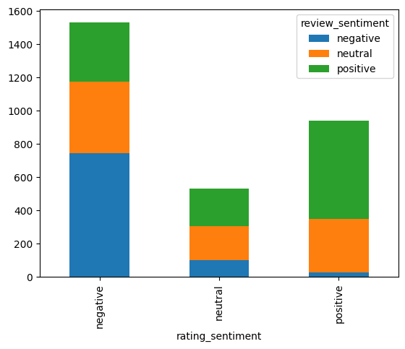
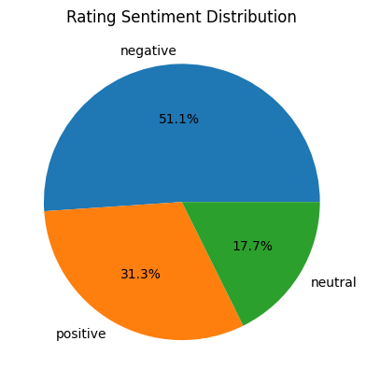
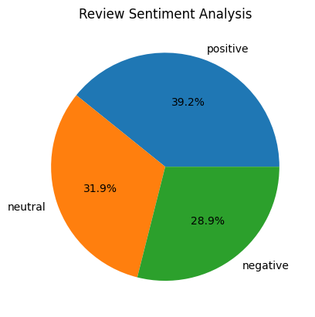
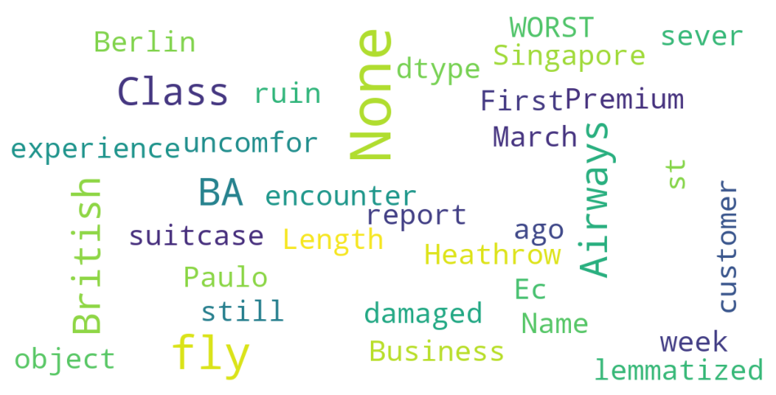
INSIGHTS FROM CUSTOMER REVIEWS
From cleaning 3000 reviews given by the customers, we obtained
Positive Reviews – 938 ratings wise, 1176 reviews wise
Negative Reviews – 1532 ratings wise, 868 reviews wise
Neutral Reviews – 530 ratings wise, 956 reviews wise
Word cloud of keywords used in reviews

